Slide 1
Goal-Oriented Data-Centric Learning
Hongfu Liu @ Brandeis
10/16/2024

Slide 2
Something about me
Appointment & Education
Current
Assistant Professor at Department of Computer Science, Brandeis University (2018-now)
Previous
Ph.D. in Computer Engineering, Northeastern University (2014-2018)
Master in Management, Beihang University (2011-2014)
Bachelor in Management, Beihang University (2007-2011)
Minor Bachelor, in Applied Mathematics, Beihang University (2007-2011)
Minor Bachelor, in Law, Beihang University (2007-2011)
Internship
Microsoft Research Asia (6/2017-8/2017)
Adobe Research (5/2016-7/2016)

Slide 3
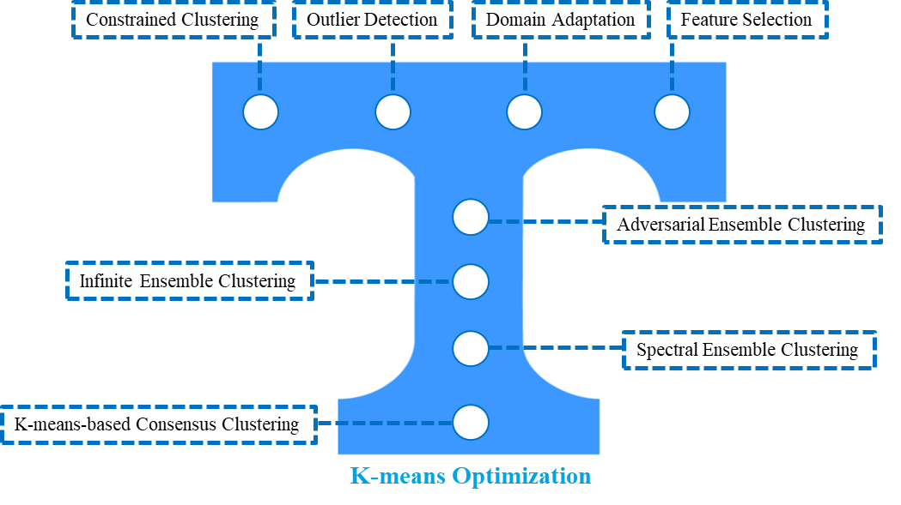
Research and Publication
Achievements
Over 100 papers in top-tier conferences and prestigious journals including KDD, NeurIPS, ICLR, ICML, CVPR, ICCV, TPAMI, and TKDE
Over 4,000 citations with h-index 37
Associate Editor of IEEE Computational Intelligence Magazine
(Senior) Area Chair of ICLR (Highlighted in 2022, Notable in 2023), NeurIPS (Notable in 2023), ICML
2021 INNS Aharon Katzir Young Investigator Award (1-2 winners per year)
2022 Global Top-25 Chinese Young AI Scholars (Data Mining Area)
Personal Research Interests
Seek shortcuts in the labyrinth
Handle emerging topics in practical scenarios

Slide 4
Today’s Topic
Goal-Oriented Data-Centric Learning

Slide 5
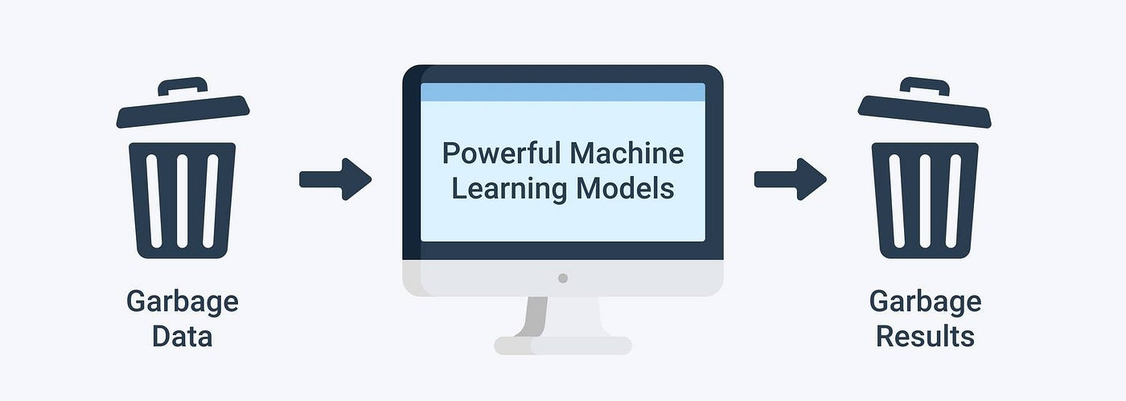
Data! Data! Data!
Garbage In, Garbage Out
What is garbage?

Slide 6
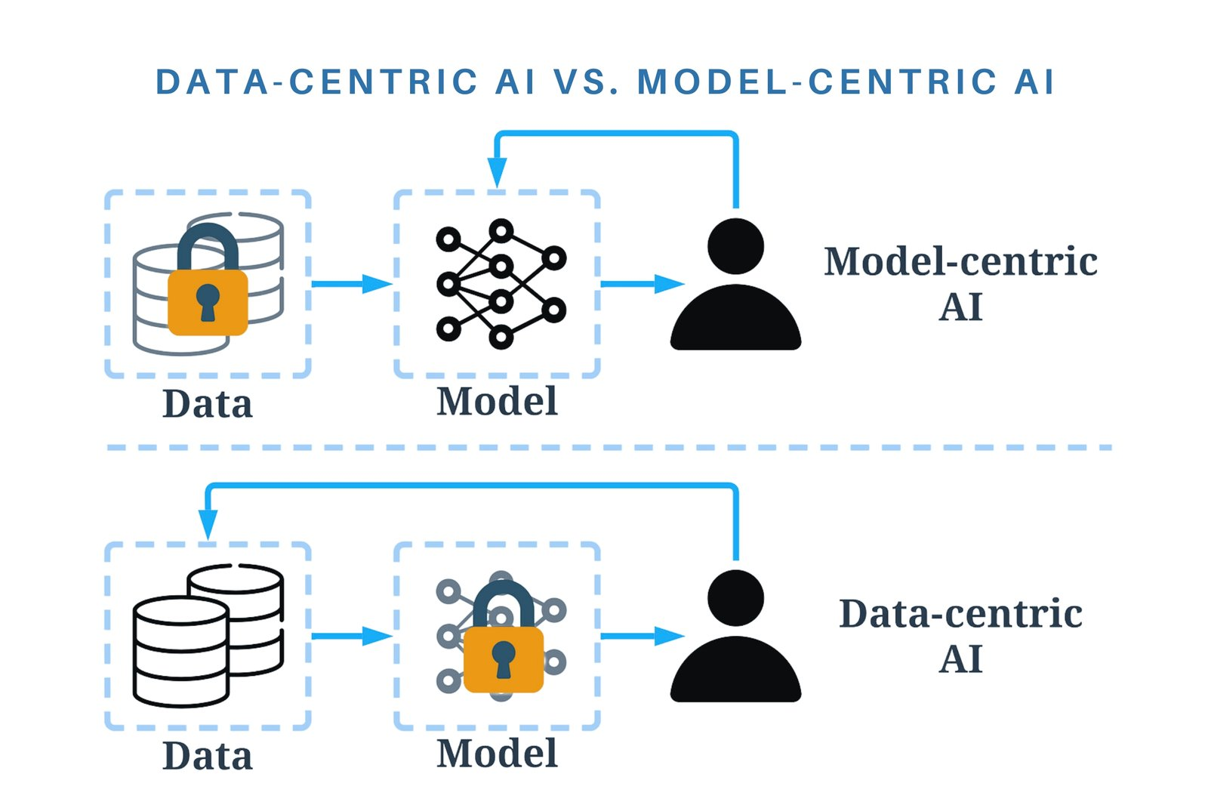
Data-Centric Learning
One man's trash is another man's treasure
The assessment of data valuation cannot be isolated from the overarching goal.
Some techniques that also focus on data, including outlier detection, data augmentation and so on, do not belong to data-centric learning.

Slide 7
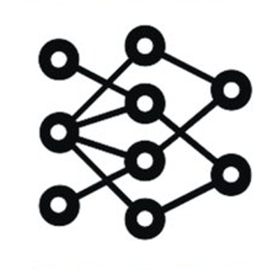
Data-Centric Learning
The fundamental question in data-centric learning is how to assess the data valuation.
One naïve way is the famous leave-one-out influence.
We measure the performance change on the validation set with one data sample removed from the training set.
Training Set
Model
Training Set
Model

Slide 8
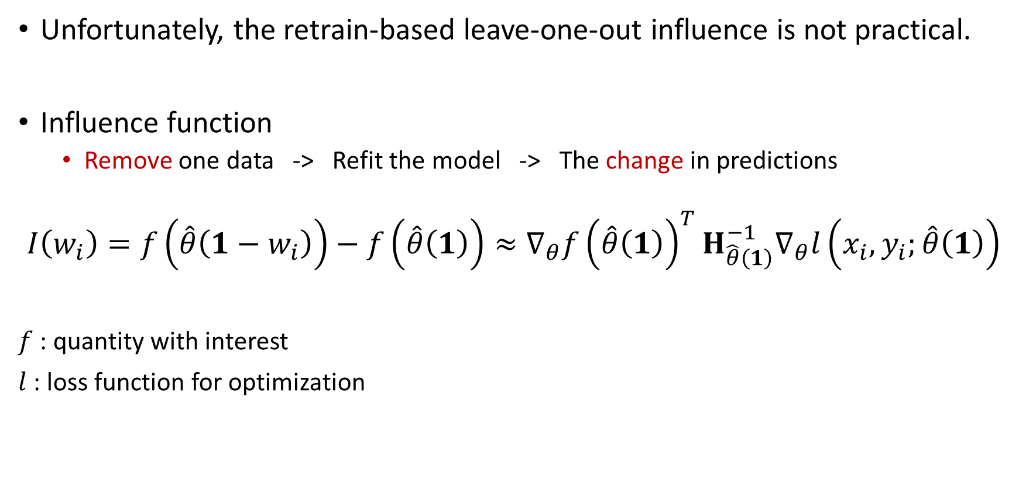
Data-Centric Learning
Unfortunately, the retrain-based leave-one-out influence is not practical.
Influence function
Remove one data -> Refit the model -> The change in predictions
$$I\left(w_{i}\right)=f\left(\hat{θ}\left(1−w_{i}\right)\right)−f\left(\hat{θ}\left(1\right)\right)≈∇_{θ}{f\left(\hat{θ}\left(1\right)\right)}^{T}H_{\hat{θ}\left(1\right)}^{−1}∇_{θ}l\left(x_{i},y_{i};\hat{θ}\left(1\right)\right)$$
$f$ : quantity with interest
$l$ : loss function for optimization

Slide 9
Outline
Identify and Trim Detrimental Samples
What Data Benefit My Classifier? - ICLR’24
Achieve Pareto Improvements When Considering Two Goals
Achieving Fairness at No Utility Cost via Data Reweighing with Influence - ICML’22
Measuring the Influence of Graph Element
Characterizing the Influence of Graph Elements - ICLR’23
Other Topics

Slide 10
Outline
Identify and Trim Detrimental Samples
What Data Benefit My Classifier? - ICLR’24
Achieve Pareto Improvements When Considering Two Goals
Achieving Fairness at No Utility Cost via Data Reweighing with Influence - ICML’22
Measuring the Influence of Graph Element
Characterizing the Influence of Graph Elements - ICLR’23
Other Topics

Slide 11
What data benefit my classifier
This is a crucial problem but overlooked for a long time.
We aim to identify and trim the detrimental samples and boost the model performance.
Here we consider the model performance in terms of utility, fairness, and adversarial robustness.

Slide 12
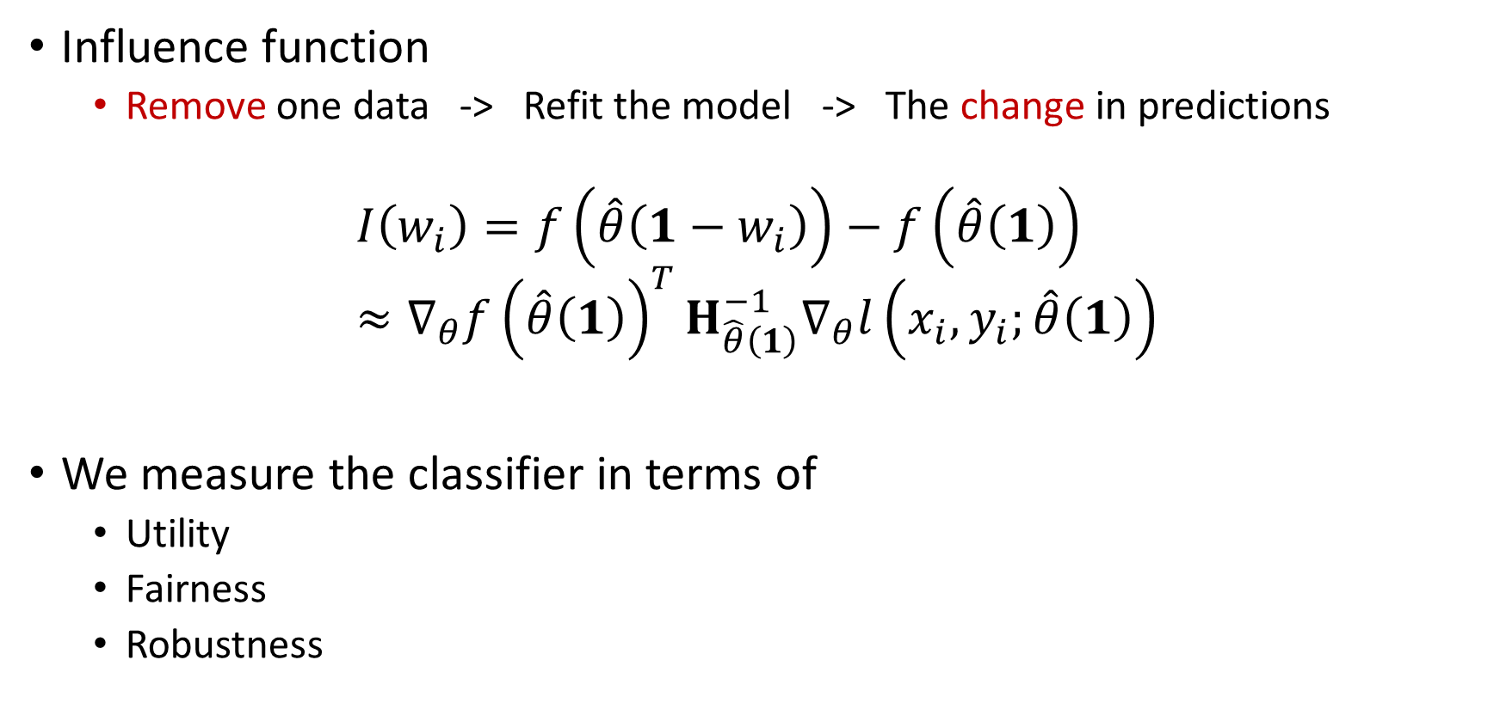
What data benefit my classifier
Influence function
Remove one data -> Refit the model -> The change in predictions
$$I\left(w_{i}\right)=f\left(\hat{θ}\left(1−w_{i}\right)\right)−f\left(\hat{θ}\left(1\right)\right)≈∇_{θ}{f\left(\hat{θ}\left(1\right)\right)}^{T}H_{\hat{θ}\left(1\right)}^{−1}∇_{θ}l\left(x_{i},y_{i};\hat{θ}\left(1\right)\right)$$
We measure the classifier in terms of
Utility
Fairness
Robustness

Slide 13
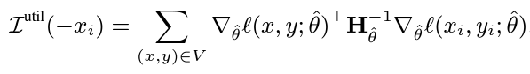
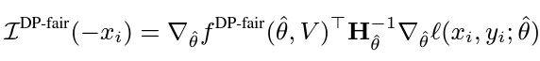
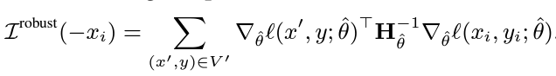
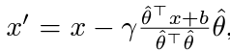
Estimate the sample influence
Influence score for each training sample

Slide 14
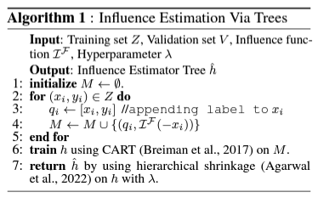
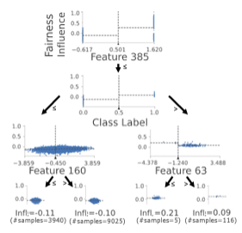
Sample Influence Understanding
Beyond identifying the detrimental/beneficial samples, we also aim to understand or interpret where the performance gain comes from

Slide 15
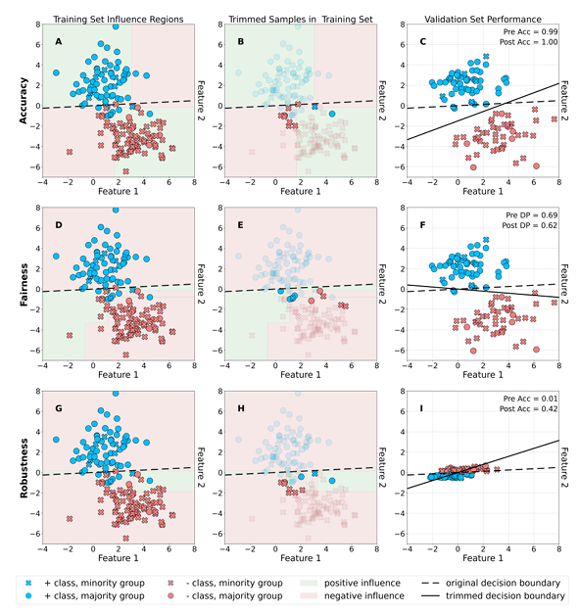
Experimental Results on Synthetic Data

Slide 16
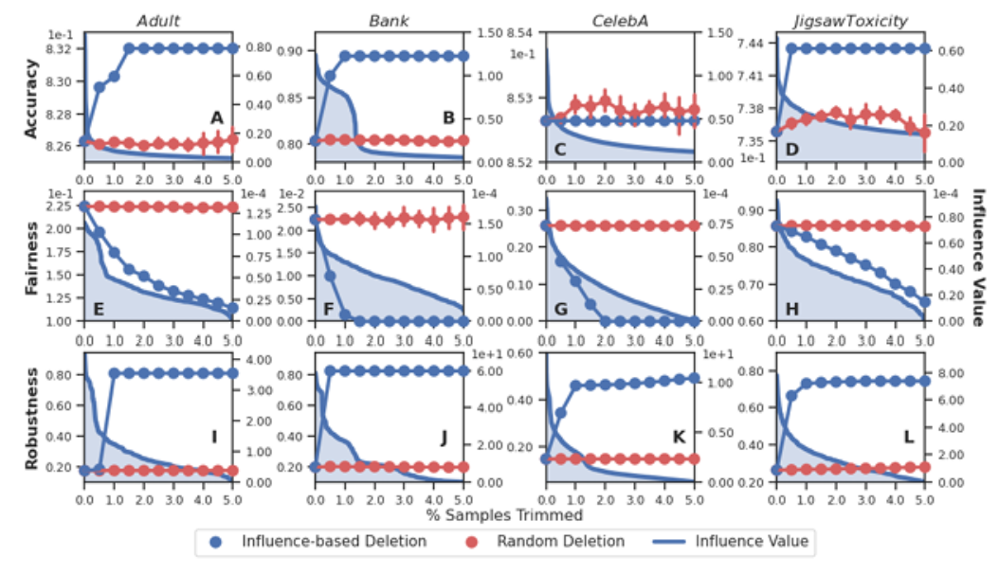
Experimental Results on Real-World Data
Two tabular, one visual, and one textual datasets
Significant improvement in fairness and robustness
10% increase in accuracy on Bank
Not require much training data

Slide 17
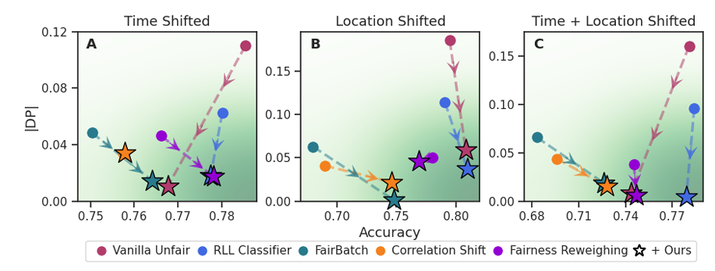
Applications Beyond Conventional Classification
Mitigating unfairness under distribution shift
Our trimming-based approach can greatly improve fairness under distribution shift.

Slide 18
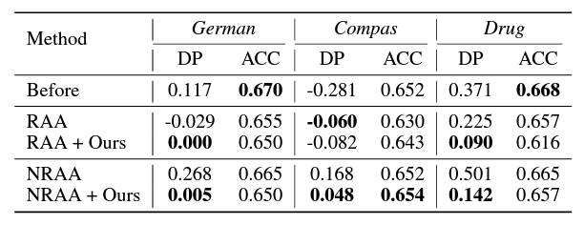
Applications Beyond Conventional Classification
Combating poisoning attack against fairness
Our trimming approach is useful for combating fairness-reducing poisoning attacks, as it improves fairness performance compared to the metric values obtained before and after the attacks

Slide 19
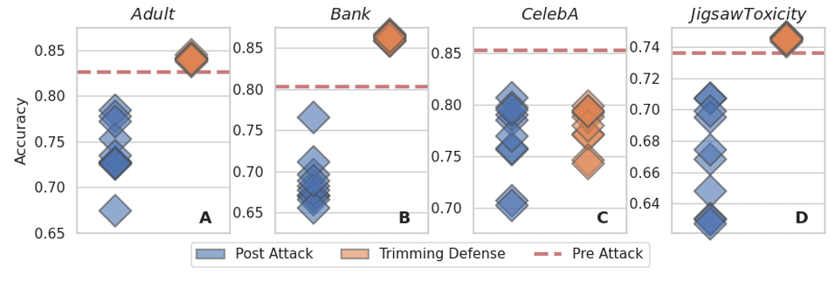
Applications Beyond Conventional Classification
Defending against adaptive evasion attacks
With just 2.5% of the training data trimmed, we find that we can increase performance well beyond pre-attack values.

Slide 20
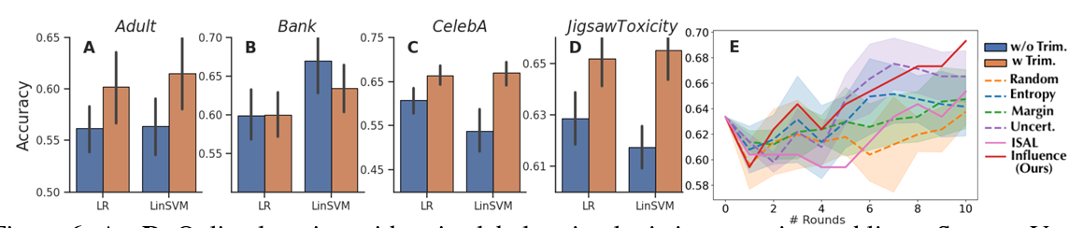
Applications Beyond Conventional Classification
Online learning with noisy label
Active learning

Slide 21
Summary
A crucial but overlooked research question
Tree-based influence estimation models to understand and interpret which sample features contribute positively or negatively to the model’s performance
Diverse and practical applications

Slide 22
Outline
Identify and Trim Detrimental Samples
What Data Benefit My Classifier? - ICLR’24
Achieve Pareto Improvements When Considering Two Goals
Achieving Fairness at No Utility Cost via Data Reweighing with Influence - ICML’22
Measuring the Influence of Graph Element
Characterizing the Influence of Graph Elements - ICLR’23
Other Topics

Slide 23
Fairness in Binary Classification
Most Fair Algorithms : Fairness Utility
Our Results : Fairness Utility
Our solution: Reweighing Training Data via Influence Functions

Slide 24
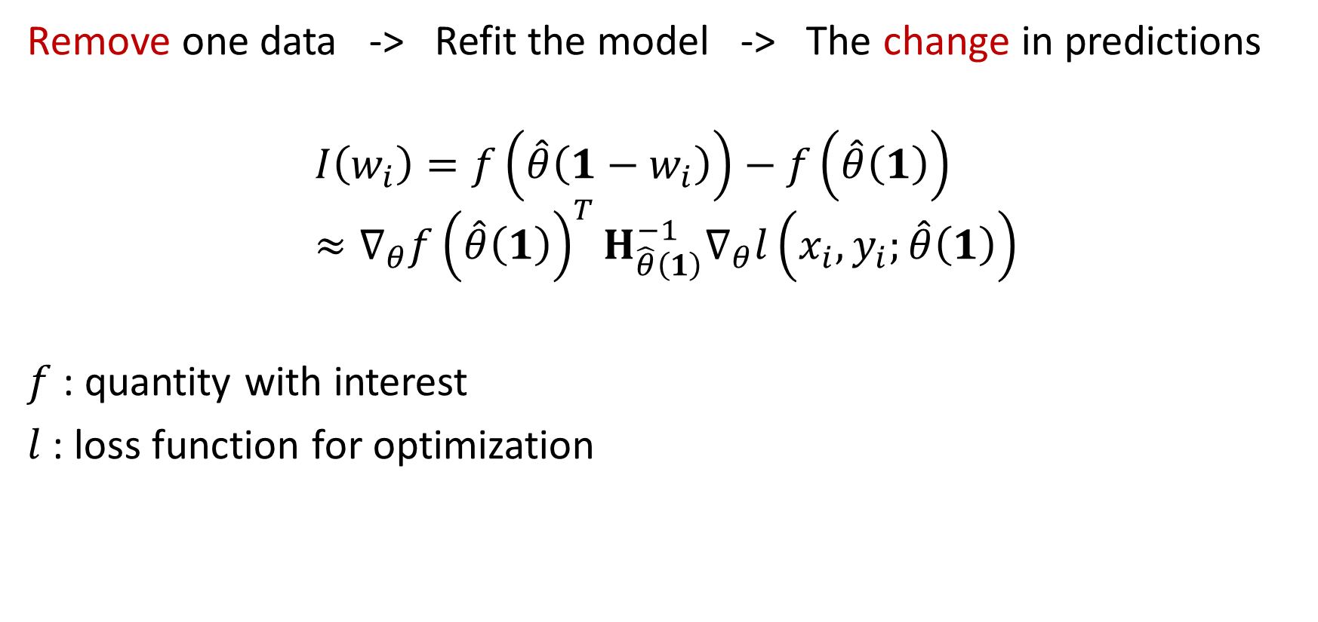
Influence Functions
Remove one data -> Refit the model -> The change in predictions
$$I\left(w_{i}\right)=f\left(\hat{θ}\left(1−w_{i}\right)\right)−f\left(\hat{θ}\left(1\right)\right)≈∇_{θ}{f\left(\hat{θ}\left(1\right)\right)}^{T}H_{\hat{θ}\left(1\right)}^{−1}∇_{θ}l\left(x_{i},y_{i};\hat{θ}\left(1\right)\right)$$
$f$ : quantity with interest
$l$ : loss function for optimization

Slide 25
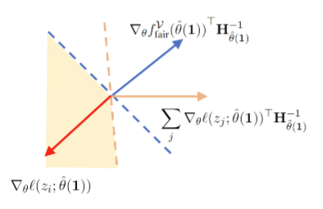
Reweighing Data via Influence Functions
Influence
Utility :
Fairness:
One Datum
Influence

Slide 26
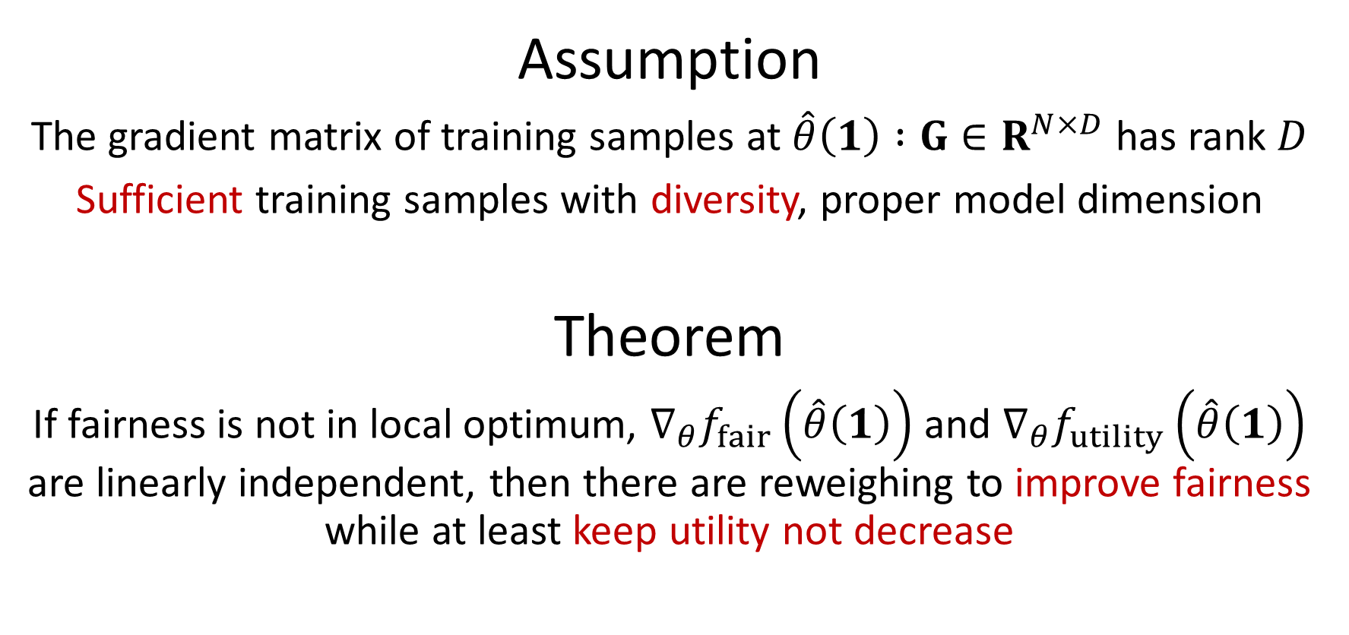
Reweighing Data via Influence Functions
Assumption
The gradient matrix of training samples at $\hat{θ}\left(1\right) :G∈R^{N×D}$ has rank $D$
Sufficient training samples with diversity, proper model dimension
Theorem
If fairness is not in local optimum, $∇_{θ}f_{fair}\left(\hat{θ}\left(1\right)\right)$ and $∇_{θ}f_{utility}\left(\hat{θ}\left(1\right)\right)$ are linearly independent, then there are reweighing to improve fairness while at least keep utility not decrease

Slide 27
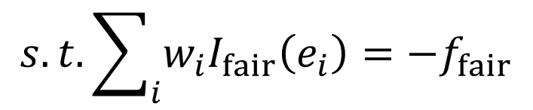
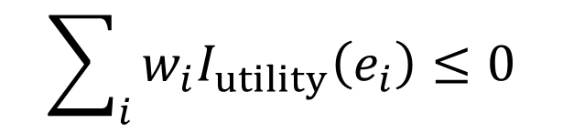
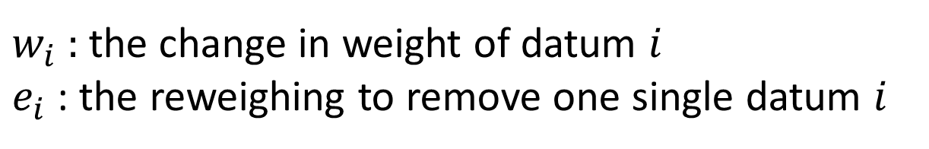


Reweighing Solution
$$Min\sum_{i}{w_{i}}$$
$$s.t. \sum_{i}{w_{i}I_{fair}\left(e_{i}\right)=−f_{fair}}$$
$$\sum_{i}{w_{i}I_{utility}\left(e_{i}\right)≤0}$$
$$w_{i}∈[0, 1]$$
$w_{i}$ : the change in weight of datum $i$
$e_{i}$ : the reweighing to remove one single datum $i$

Slide 28
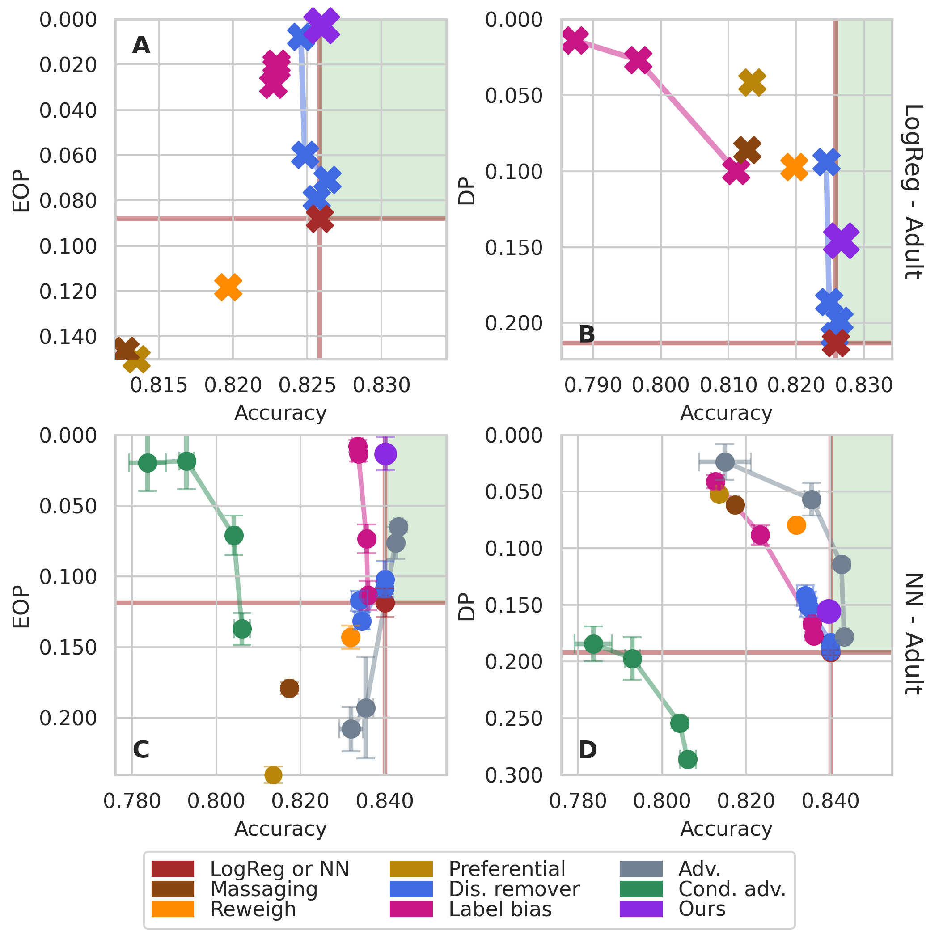
Results
Fairness
Vanilla Classifier
Utility
Pareto solutions achieved

Slide 29
Summary
A pre-processing (data-centric) approach for group fairness
Better fairness and non-decreasing utility

Slide 30
Outline
Identify and Trim Detrimental Samples
What Data Benefit My Classifier? - ICLR’24
Achieve Pareto Improvements When Considering Two Goals
Achieving Fairness at No Utility Cost via Data Reweighing with Influence - ICML’22
Measuring the Influence of Graph Element
Characterizing the Influence of Graph Elements - ICLR’23
Other Topics

Slide 31
Measuring the Influence of Graph Element
We focus on the semi-supervised node-classification scenario.
Without model retraining, how can we estimate the changes of parameters in GNNs when the graph used for learning is perturbed by edge-or node-removals?

Slide 32
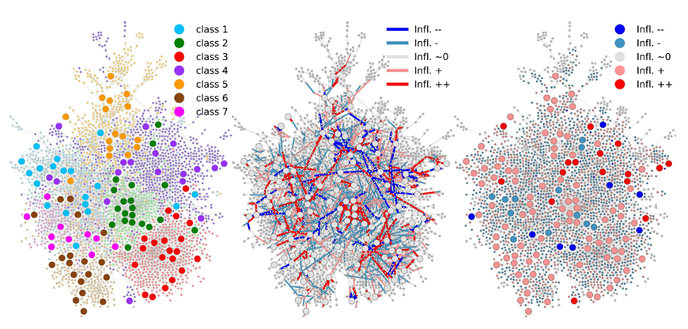
Experimental Results

Slide 33
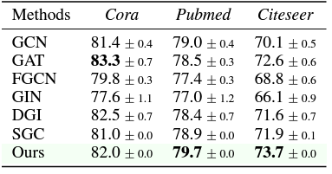
Experimental Results
Eliminating edges with negative influence values.

Slide 34
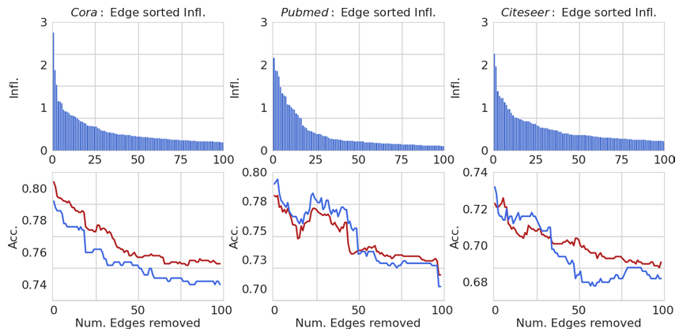
Experimental Results
Study of edges with a positive influence on both validation and test set

Slide 35
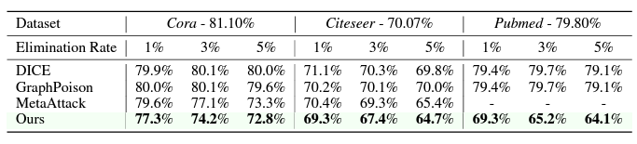
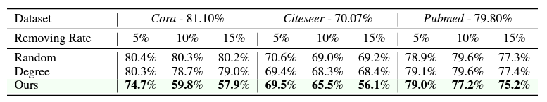
Experimental Results
Grey-box attacks to GCN via edge removals.
Performance of node removing attack.

Slide 36
Summary
Extend influence function measuring from tabular data to graph elements
Identify positive or negative edges or nodes.

Slide 37
Outline
Identify and Trim Detrimental Samples
What Data Benefit My Classifier? - ICLR’24
Achieve Pareto Improvements When Considering Two Goals
Achieving Fairness at No Utility Cost via Data Reweighing with Influence - ICML’22
Measuring the Influence of Graph Element
Characterizing the Influence of Graph Elements - ICLR’23
Other Topics

Slide 38
Other Topics
Applied scenarios
Data trimming (done)
Data reweighing (done)
Active learning (done)
Poisoning attack (done)
Distribution shift (done)
LLM fine-tune (under submission)
Noisy label correction (under submission)
Influential sample identification (under submission)
Data price (under submission)
Data augmentation (ongoing)
Data-model cooperative learning (ongoing)
Data-centric for semi-supervised learning (ongoing)
Model performance ceiling detection (ongoing)
Data efficiency (ongoing)
Algorithmic recourse (future work)

Slide 39
Other Topics
Influence function is not omnipotent.
The strong convexity assumption on the model and the computational cost associated with calculating the inverse of the Hessian matrix pose constraints, particularly when analyzing large deep models.
A surrogate convex model with deep embeddings is an alternative solution.
Fortunately, our ongoing several works tackle the above challenges via equivalence transformation. Coming soon~

Slide 40
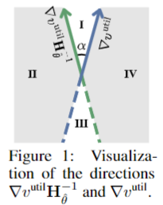
Papers Under Submission
Better Naive Than Wrong: Revisit, Extend, and Enhance Hessian-Free Influence Functions
Ziao Yang, Han Yue, Jian Chen, Hongfu Liu
Motivation: High-Costly of the inverse of Hessian Matrix

Slide 41
Papers Under Submission
Outlier Gradient Analysis: Efficiently Improving Deep Learning Model Performance via Hessian-Free Influence Functions
Anshuman Chhabra, Bo Li, Jian Chen, Prasant Mohapatra, Hongfu Liu
Motivation: High-Costly of the inverse of Hessian Matrix and Convex Assumption
Constant
Concept-level Equivalence
Outlier Gradient Analysis

Slide 42
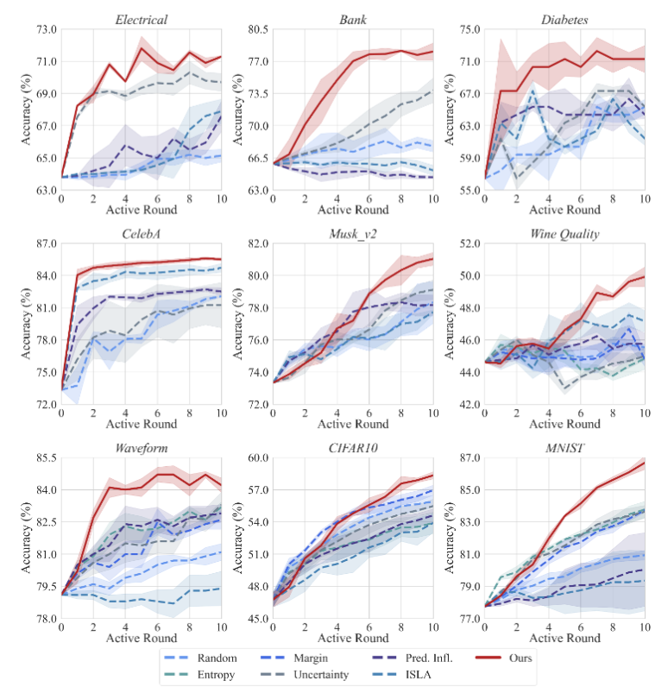
Papers Under Submission
Autonomous Salutary Labeling with Zero Human Annotation
Wenxiao Xiao, Hongfu Liu
Motivation: Active learning usually employs the indirect measurements for sample selection; Annotation needs costly labors.
From ground truth label to salutary label

Slide 43





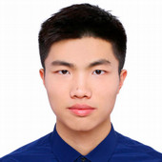
Acknowledgement
Peizhao Li
Anshuman Chhabra
Zizhang Chen
Han Yue
Wenxiao Xiao
Ziao Yang

Slide 44
Thanks
Q & A

Slide 45
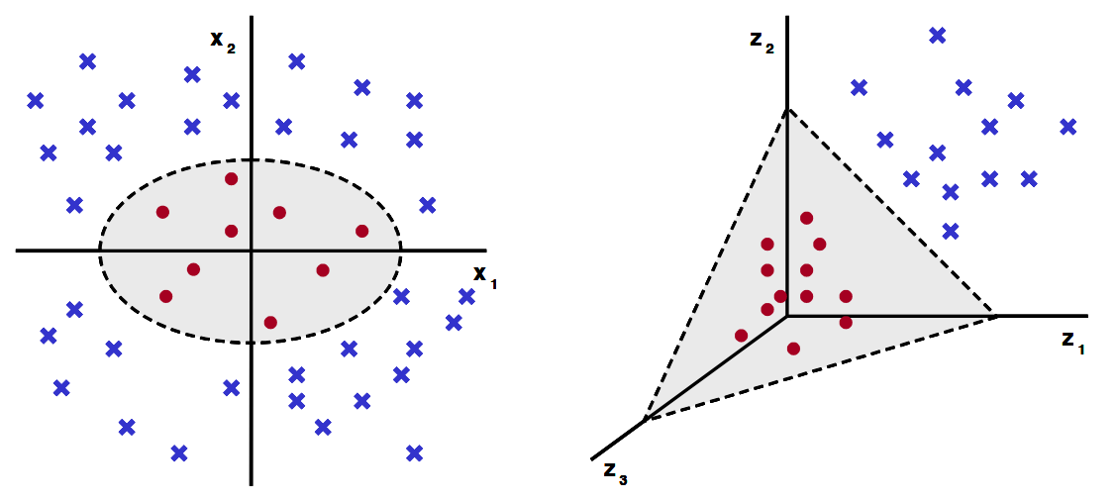
Personal Research Interests
Seek shortcuts in the labyrinth
Transforming Complex Problems into K-means Solutions. IEEE Transactions on Pattern Analysis and Machine Intelligence (TPAMI-Survey), 2023.

Slide 46




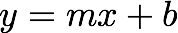




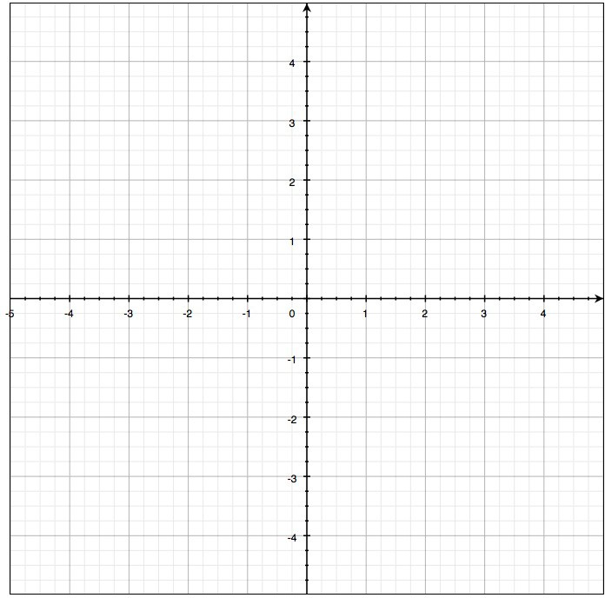
Image and parameter space
variables
parameters
Image space

Slide 47
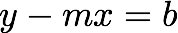


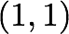

Image and parameter space
variables
variables
parameters
parameters
a line becomes a point
Image space
Parameter space

Slide 48
Image and parameter space
variables
parameters
What would a point in image space become in parameter space?
Image space

Slide 49
Image and parameter space
variables
variables
parameters
parameters
a point becomes a line
Image space
Parameter space

Slide 50
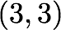


Image and parameter space
variables
variables
parameters
parameters
two points become
?
Image space
Parameter space

Slide 51

Image and parameter space
variables
variables
parameters
parameters
two points become
?
Image space
Parameter space

Slide 52

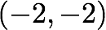

Image and parameter space
variables
variables
parameters
parameters
three points become
?
Image space
Parameter space

Slide 53
Image and parameter space
variables
variables
parameters
parameters
three points become
?
Image space
Parameter space

Slide 54




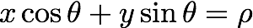
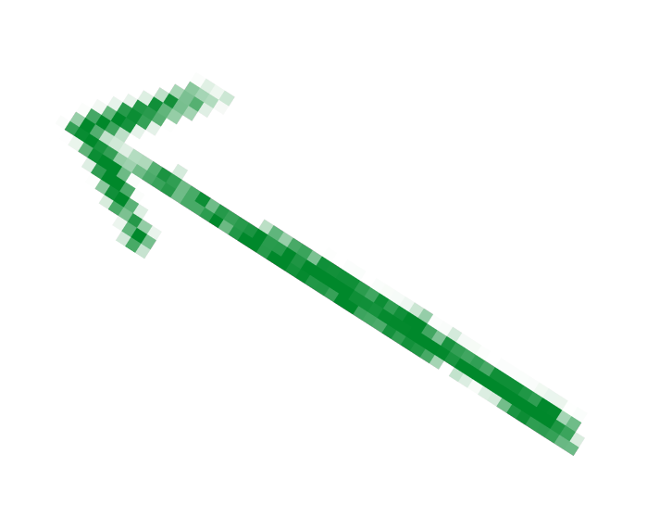



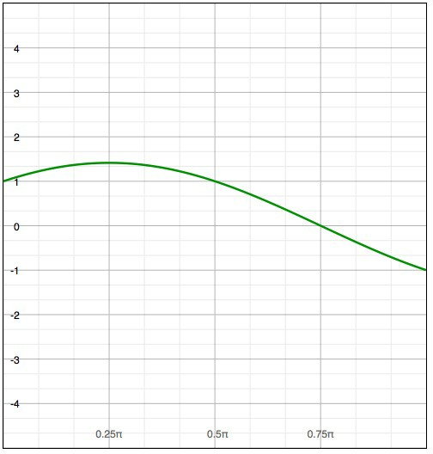
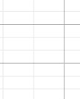
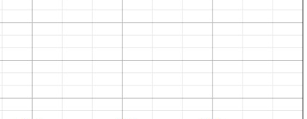
Image and parameter space
variables
parameters
parameters
variables
a point becomes?
Image space
Parameter space

Slide 55
Image and parameter space
variables
parameters
a line becomes?
Image space
Parameter space

Slide 56
Image and parameter space
variables
parameters
a line becomes a point
Image space
Parameter space

Slide 57
Image and parameter space
variables
parameters
a line becomes?
Image space
Parameter space

Slide 58
Image and parameter space
variables
parameters
a line becomes a point
Image space
Parameter space

Slide 59
Image and parameter space
variables
parameters
a line becomes a point
Image space
Parameter space

Slide 60
Image and parameter space
variables
parameters
a line becomes a point
Image space
Parameter space

Slide 61
Image and parameter space
variables
parameters
a line becomes a point
Image space
Parameter space

Slide 62
Image and parameter space
variables
parameters
a line becomes a point
Image space
Parameter space

Slide 63

Image and parameter space
variables
parameters
Wait …why is rho negative?
a line becomes a point
Image space
Parameter space

Slide 64
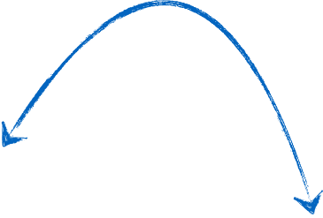
Image and parameter space
variables
parameters
same line through the point
Image space
Parameter space

Slide 65
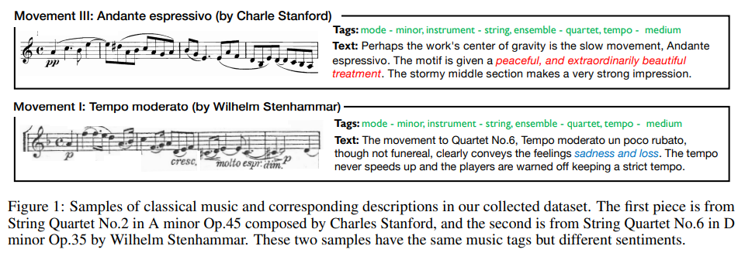
Personal Research Interests
Handle emerging topics in practical scenarios
Music-to-Text Synaesthesia: Generating Descriptive Text from Music Recordings

